Slide 1
GPU based Deconvolution GUI on Windows
Please acknowledge NIMH SNIR (Systems Neuroscience Imaging Resource) in any publication that takes advantage of this code.
Contacts:
snehashis.roy@nih.gov
usdint@mail.nih.gov
https://www.nimh.nih.gov/research/research-conducted-at-nimh/research-areas/clinics-and-labs/snir

Slide 2
Content
Windows GUI for Deconvolution
Prerequisites
Dependencies & their installation process
Deconvolution example

Slide 3
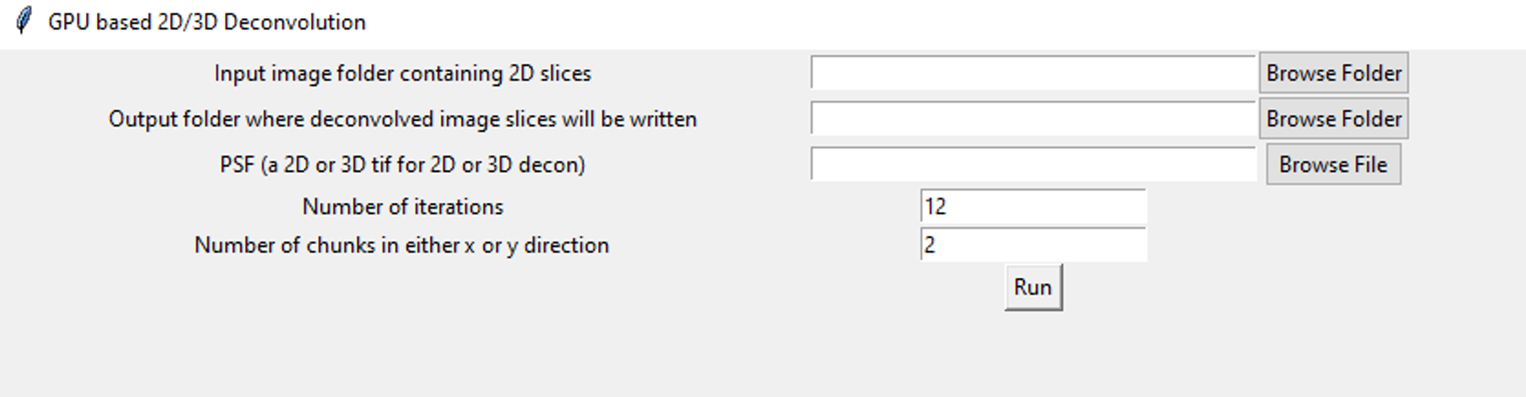
Deconvolution GUI
Deconvolution
Features:
2D/3D deconvolution
Richardson-Lucy
Any size (>10TB) image is acceptable
Limitation
Single GPU for Windows (unlimited for Linux)

Slide 4
Prerequisites
Any size 2D/3D image (could be multi Terabytes) is acceptable as long as it is
a single channel
stored in a folder as 2D slices in tif format
8/16/32-bit tif
Unacceptable:
Multi-channel images in the same folder are not acceptable. Multiple channels are acceptable as long as they are single channel files that the same psf or denoise model can be used with. If different models are required use different folders for each channel.
Color images are not acceptable
A single 3D tif is not acceptable
Only tif format is acceptable, other formats (nd2, lif etc) are not.
OME-TIFF is not recommended but may work

Slide 5
Dependencies
The scripts can be run both on Linux and Windows
Tested on Rocky 8.10, RHEL 8.10, and Windows 10
The scripts have been tested under the following strict dependencies for Windows,
Anaconda, Python 3.10
CUDA 11.8
cuDNN 8.9.7 for CUDA 11.x
cuCIM 21.08.01
Administrator access is necessary on Windows (but not for Linux).

Slide 6
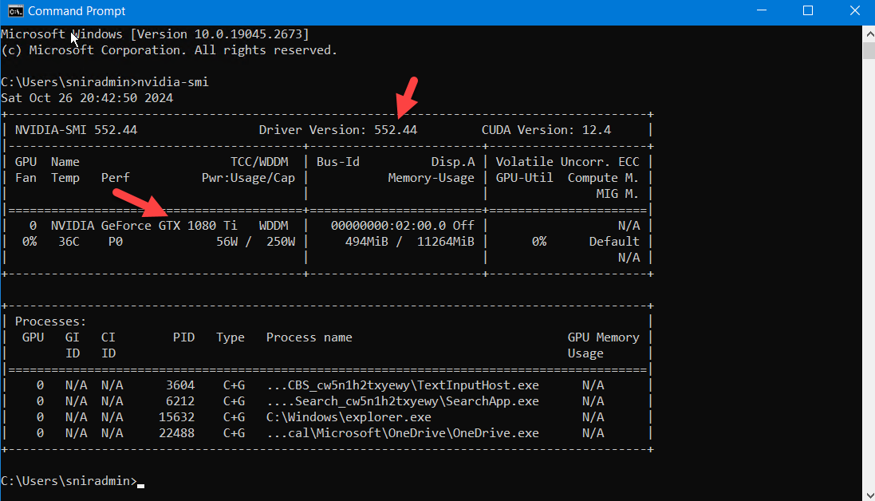
Dependencies
Please make sure NVIDIA drivers are installed.
To check if latest NVIDIA drivers are installed, enter nvidia-smi in a cmd
The output should show driver version (e.g. 552.44) and the graphics card model (e.g. GTX 1080Ti)
If drivers are not installed, download from here,
https://www.nvidia.com/en-us/drivers/

Slide 7
Download Dependencies
Download all dependencies from here,
Each one can also be individually downloaded if preferred,
Anaconda, Python 3.10,
CUDA 11.8
cuDNN 8.9.7 for CUDA 11.x (free login required)
cuCIM 21.08.01
See slice #22 for additional detail
http://hpc.nih.gov/~NIMH_MHSNIR/dependencies_for_decon.zip
https://repo.anaconda.com/archive/Anaconda3-2023.03-1-Windows-x86_64.exe
https://developer.nvidia.com/cuda-11-8-0-download-archive
https://developer.nvidia.com/rdp/cudnn-archive
https://github.com/rapidsai/cucim/releases/tag/v21.08.01

Slide 8
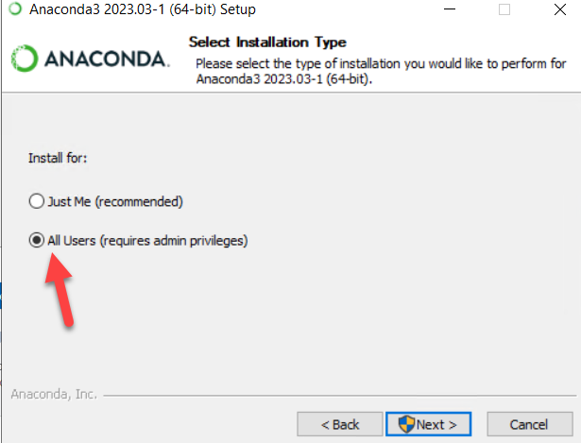
Install Dependencies - Anaconda
Install Anaconda for all users (requires administrator privilege)

Slide 9
Install Dependencies - Anaconda
The default installation location is C:\ProgramData\anaconda3. If Anaconda already exists there, choose a new location, e.g. C:\ProgramData\anaconda3.10
During installation, make sure to
Create start menu shortcuts
Register Anaconda as system Python
Clear cache upon completion

Slide 10
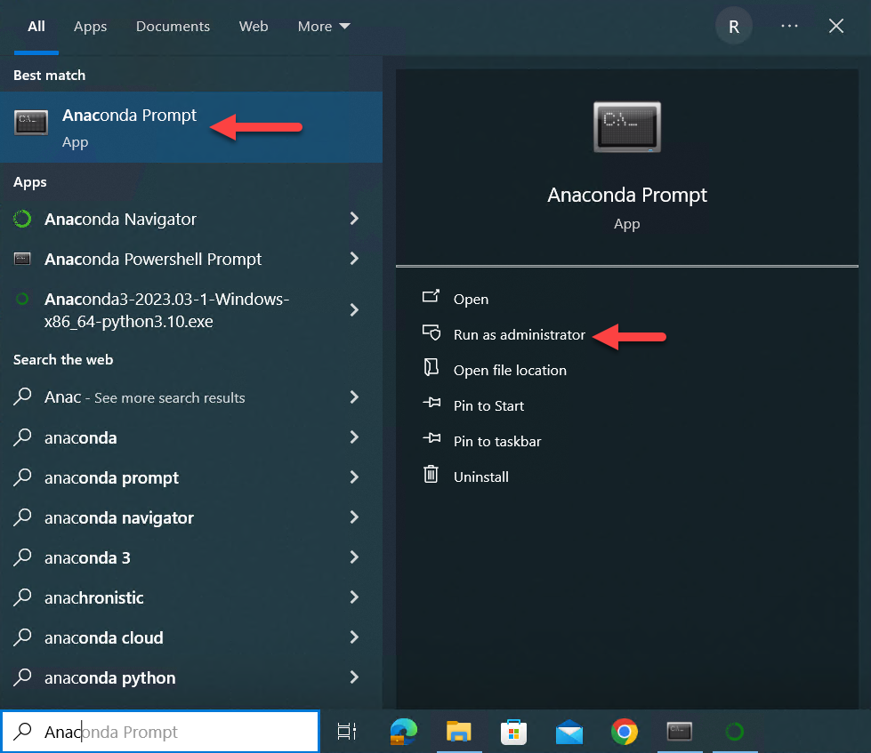
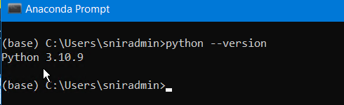
Install Dependencies - Anaconda
After completion (takes long time), search for “Anaconda Prompt” in the Windows search bar and run as admin.
It is not the regular cmd or a powershell
(It is better to be logged in as a regular user
and run as admin vs logging in as admin)
Confirm successful installation of Python by entering python --version

Slide 11
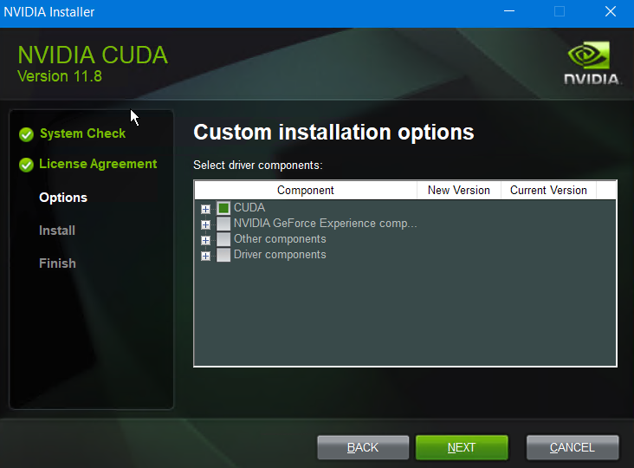
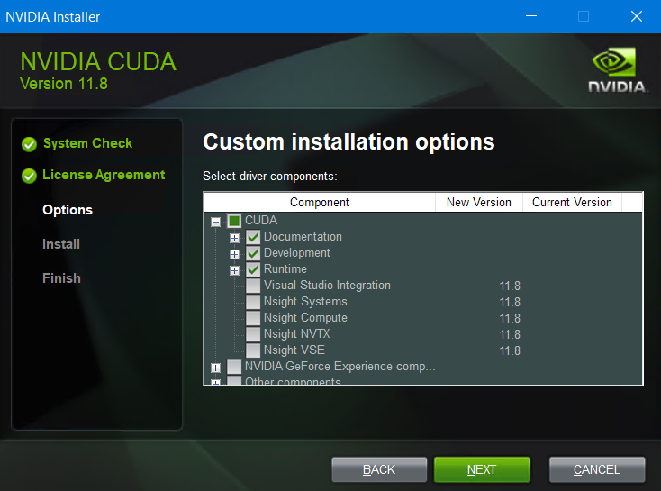
Install Dependencies – CUDA 11.8
Even if there is an existing CUDA with higher version, install 11.8
Choose “Custom (Advanced)” installation instead of Express.
Choose only the required options as shown below and switch off others,

Slide 12
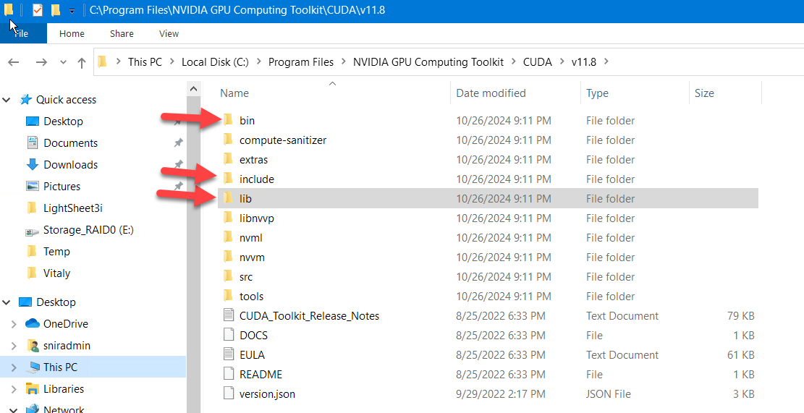
Install Dependencies – CUDA 11.8
Default installation directory,
C:\Program Files\NVIDIA GPU Computing Toolkit\CUDA\v11.8
Check that there are “bin”, “lib”, and “include” folder inside. The “lib” folder should also contain an “x64” folder.

Slide 13
Install Dependencies - cuDNN
Extract the “cudnn-windows-x86_64-8.9.7.29_cuda11-archive.zip” file to somewhere suitable
It also contain “bin”, “lib”, and an “include” folder.
Copy/move the contents of the bin folder to the CUDA 11.8 bin folder (see previous slide)
Copy/move the contents of the include folder to CUDA 11.8 include folder
Copy/move the contents of the lib\x64 folder to CUDA 11.8 lib\x64 folder

Slide 14
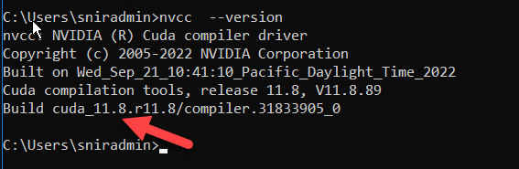
Install Dependencies - cuDNN
Check successful installation of CUDA by running nvcc --version on a cmd
It should show 11.8

Slide 15
Install Other Dependencies
Open “Anaconda Prompt” as administrator
Run the following commands:
pip install nibabel
pip install pynvml
pip install scipy==1.13.0
pip install scikit-image==0.21.0
pip install --upgrade pillow
pip install --upgrade imagecodecs
pip install tensorflow-gpu==2.10.0
pip install cupy-cuda11x

Slide 16
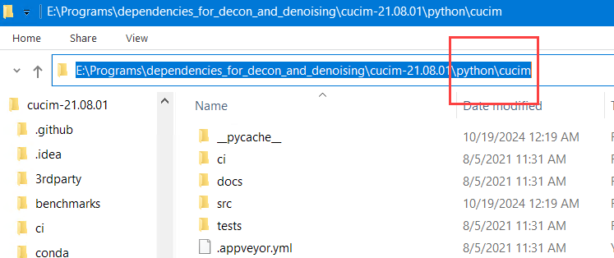
Install Dependencies - cuCIM
Extract the “cucim-21.08.01.zip” file somewhere suitable.
There is a folder called python\cucim inside it.
Open “Anaconda Prompt” as administrator.

Slide 17
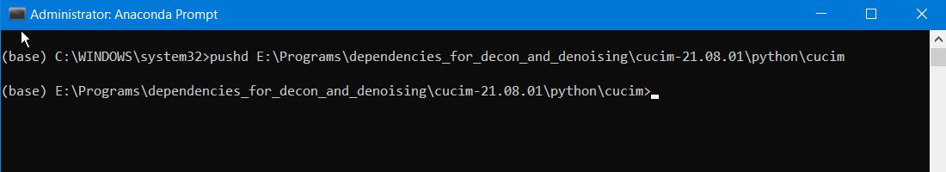
Install Dependencies - cuCIM
Type pushd followed by that folder path.
Copy the folder path from Windows explorer
Right click on the prompt to paste it
The folder now changes to the python\cucim folder

Slide 18
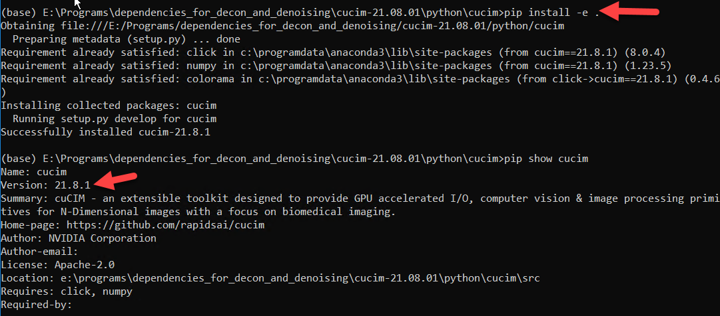
Install Dependencies - cuCIM
Type pip install -e .
Note the extra “dot” after e and a “dash” before e
Confirm successful installation by pip show cucim
It should show version 21.8.1

Slide 19
Why cuCIM 21.08.1?
See these discussions
https://github.com/rapidsai/cucim/issues/86
https://github.com/rapidsai/cucim/issues/86#issuecomment-905919774
Note that these two files that should be modified by 1 line from the Github’s version of 21.08.1 to comply with cupyx-cuda11x
.src\cucim\python\cucim\src\cucim\skimage\_vendored\signaltools.py
.src\cucim\python\cucim\src\cucim\skimage\_vendored\_signaltools_core.py
In both files, this line should be changed (already changed in version in the dependency zip file)
from cupyx.scipy.ndimage import filters
to this,
from cupyx.scipy.ndimage import _filters
i.e., filters→ _filters

Slide 20
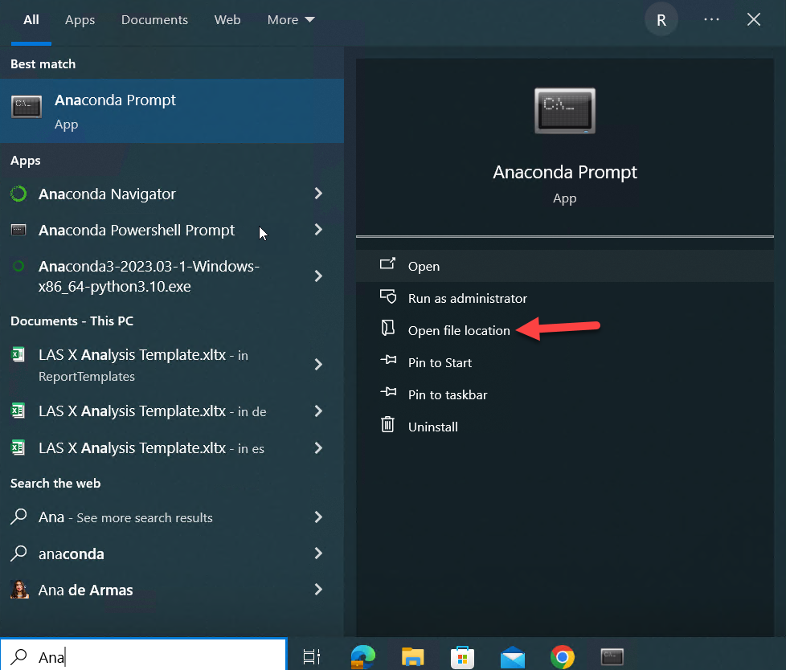
Final Installation Step
For ease of running GUI, copy the “Anaconda Prompt” shortcut to the Denoising and Deconvolution folders (see slide #7)
Search for Anaconda Prompt and open file location to copy the shortcut
The shortcut is usually located here,
C:\ProgramData\Microsoft\Windows\Start Menu\Programs\Anaconda3 (64-bit)

Slide 21
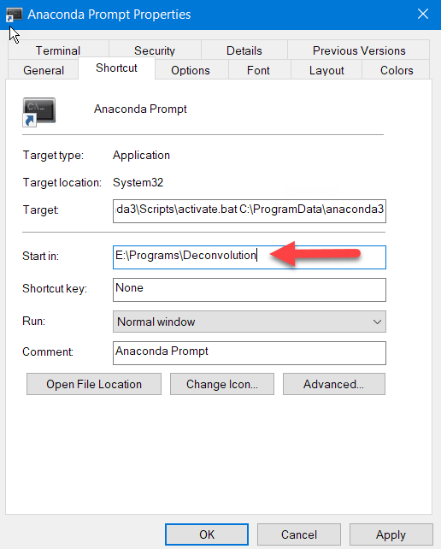
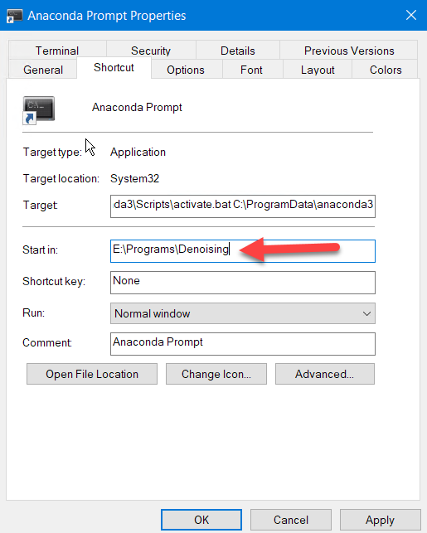
Final Installation Step
Within each folder, right click on Anaconda Prompt, change the “Start in” location to that folder location where the “Denoising” and “Deconvolution” folders were extracted

Slide 22
Content
GUIs for Deconvolution and denoising
Prerequisites
Installation of dependencies
Deconvolution
Denoising

Slide 23
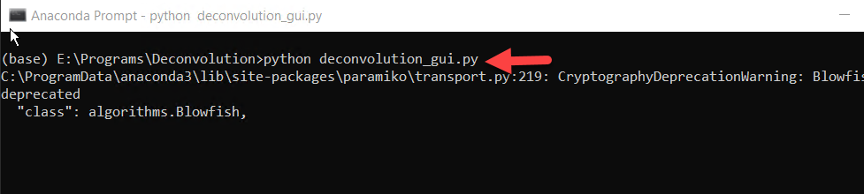
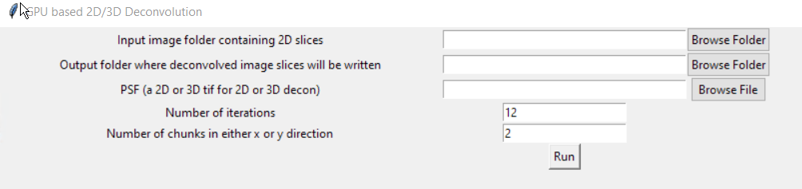
Deconvolution GUI
Double click the Anaconda Prompt within the Deconvolution folder
Type python deconvolution_gui.py
The GUI should open

Slide 24
Deconvolution Input & Output
Input folder must contain single channel 2D tif images (see slide #8)
Deconvolved images will be written as 16-bit 2D tifs in the output folder
Depending on PSF dimension and size, choose number of chunks
Too many chunks will slow down the speed
Too few chunks will incur in out of memory (OOM) error
A good rule of thumb is to use number of chunks that results in approximately 2000x2000pixels chunksize for 2D decon

Slide 25
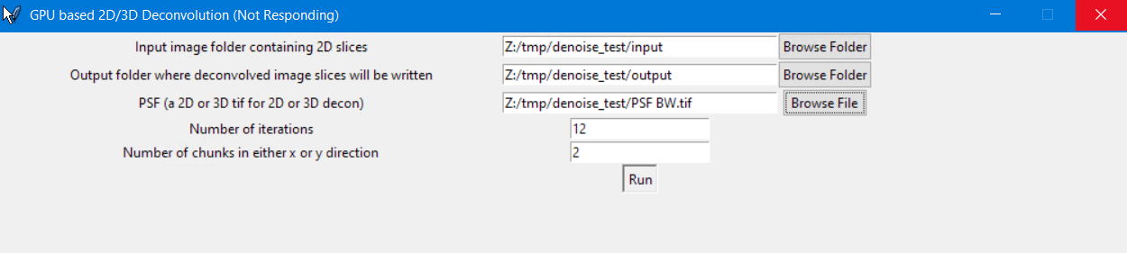
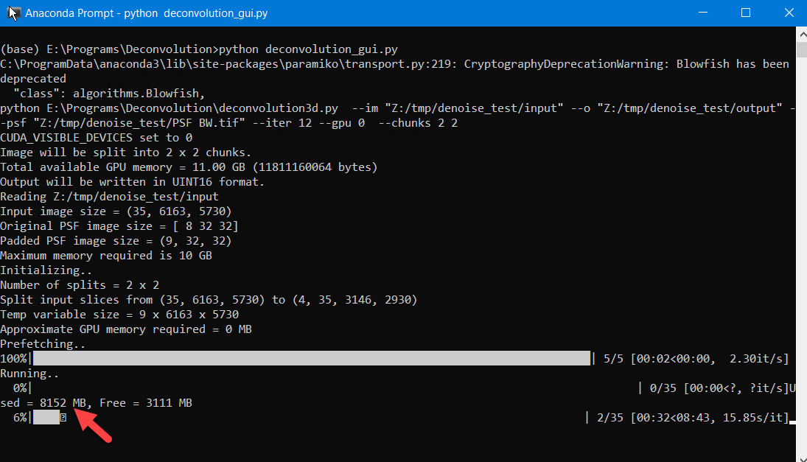
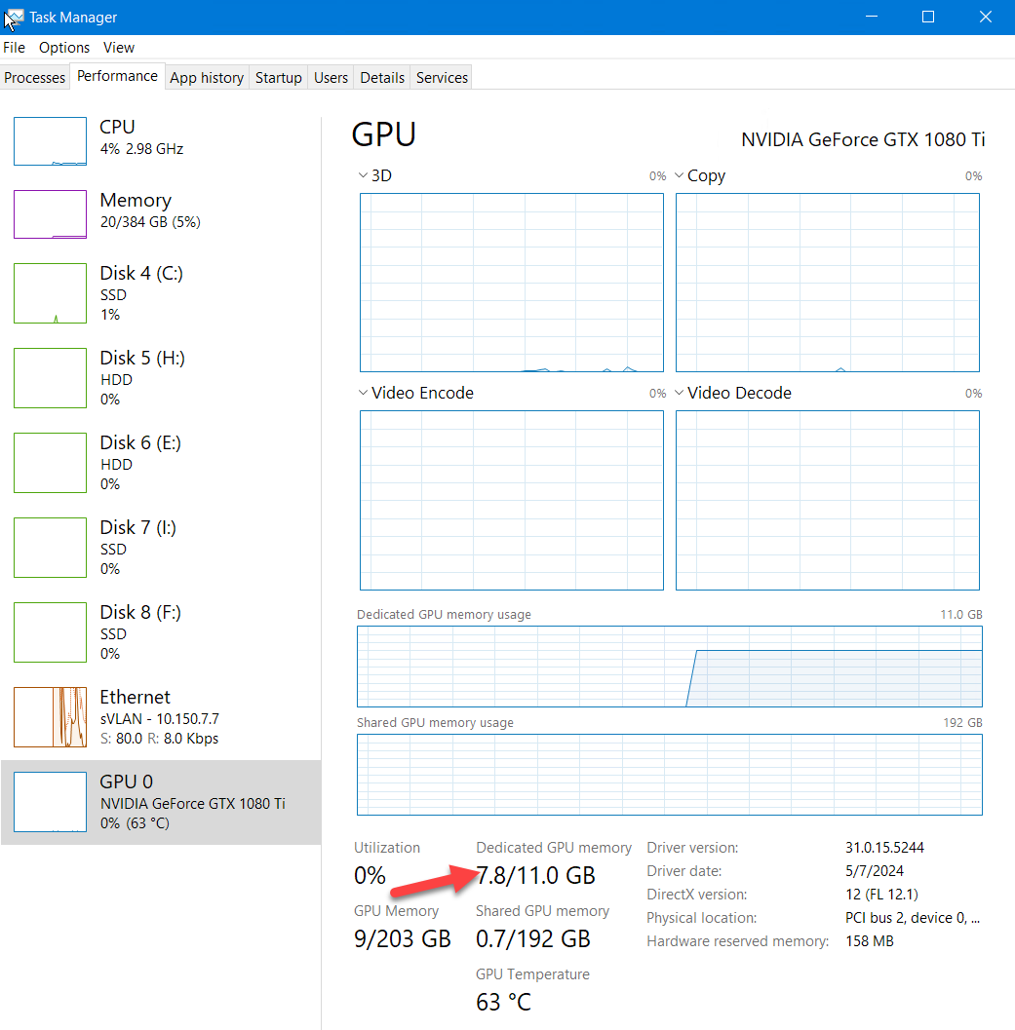
Deconvolution
Note: content of folders does not appear in this GUI;
check content using Explorer

Slide 26
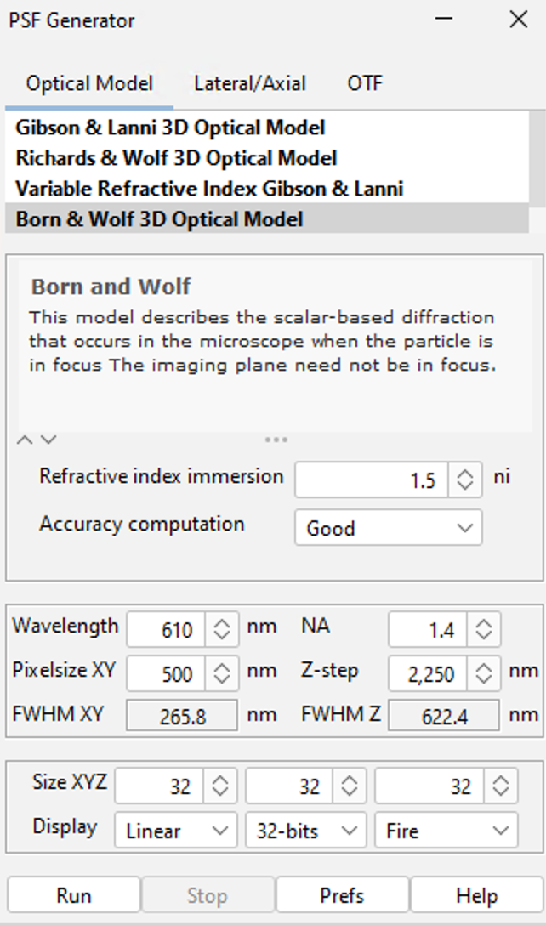
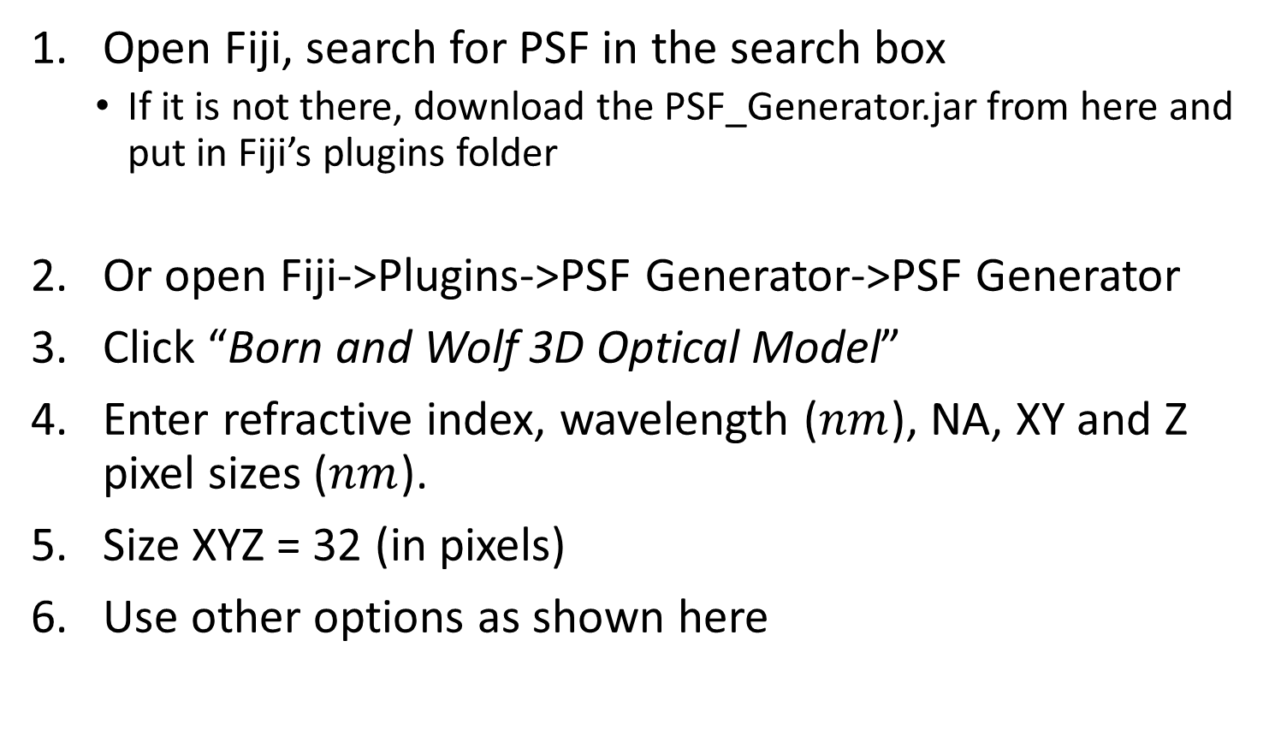
How to get Theoretical PSF
Open Fiji, search for PSF in the search box
If it is not there, download the PSF_Generator.jar from here and put in Fiji’s plugins folder
Or open Fiji->Plugins->PSF Generator->PSF Generator
Click “Born and Wolf 3D Optical Model”
Enter refractive index, wavelength ($nm$), NA, XY and Z pixel sizes ($nm$).
Size XYZ = 32 (in pixels)
Use other options as shown here
https://bigwww.epfl.ch/algorithms/psfgenerator/

Slide 27

If Z resolution $≥$ 5x the XY resolution
If z resolution is more than 5 times the x-y resolution, 2D deconvolution is visually better than 3D
In that case, after generating the resampled PSF, if the z dimension is not already 1, delete all but the middle slice.
Then the final PSF is a single slice 2D image, and the deconvolution will be 2D

Slide 28
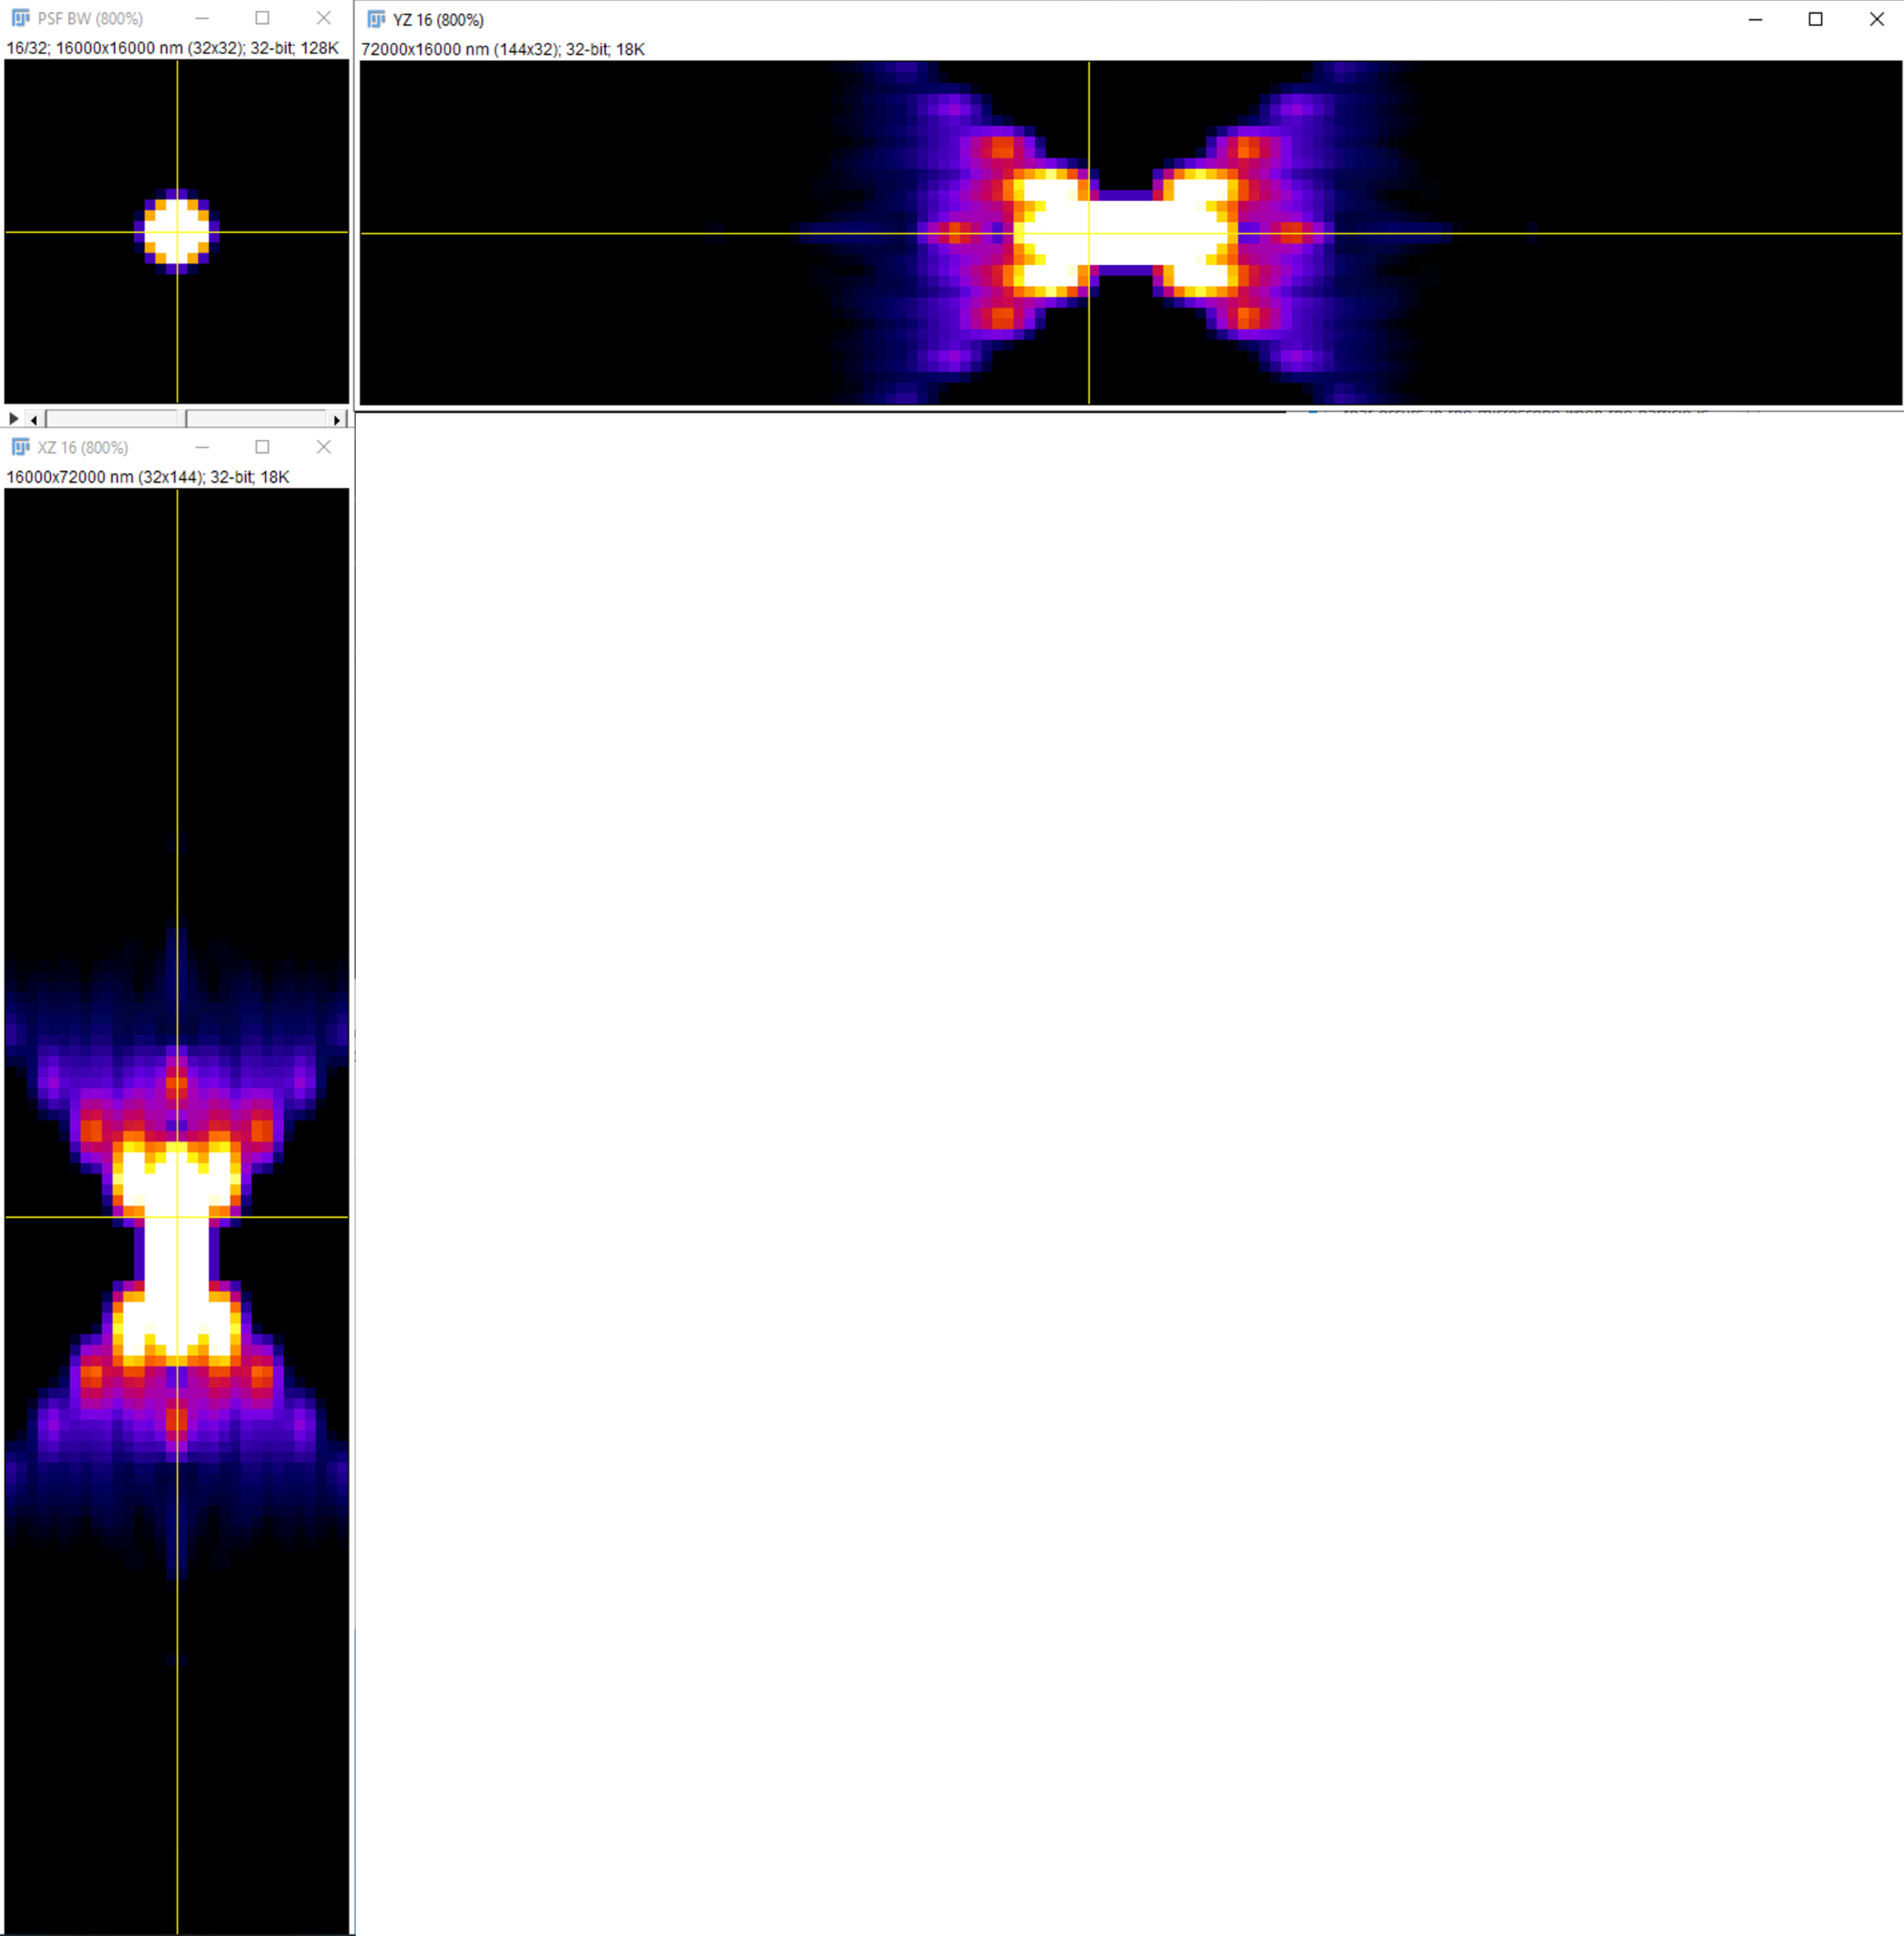
Make PSF z Size Smaller
Number of z-slices in the PSF determines required memory and speed of deconvolution.
Most often, many slices in the PSF are empty or very small, which do not contribute to the deconvolution but increases required memory and time exponentially.
Scale the image between 0 and 0.05 (or 5% of the max)
Using a 3-view in Fiji, delete first and last couple of empty slices (Fiji -> Image -> Stacks -> Delete Slice)

Slide 29
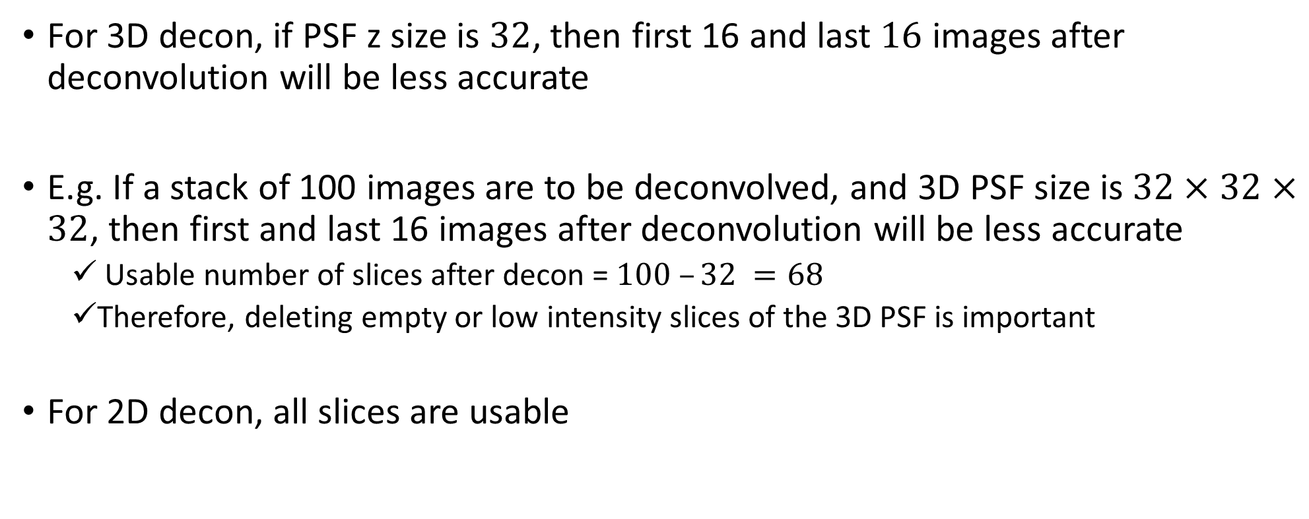
Boundary Condition
For 3D decon, if PSF z size is $32$, then first 16 and last $16$ images after deconvolution will be less accurate
E.g. If a stack of 100 images are to be deconvolved, and 3D PSF size is $32×32×32$, then first and last 16 images after deconvolution will be less accurate
Usable number of slices after decon = $100 –32 =68$
Therefore, deleting empty or low intensity slices of the 3D PSF is important
For 2D decon, all slices are usable

Slide 30
DeconWolf for Theoretical PSF
Deconwolf has better theoretical PSF than Fiji’s B&W model
https://github.com/elgw/deconwolf

